Slide 1
Title
Meeting title/Meeting date

Slide 2
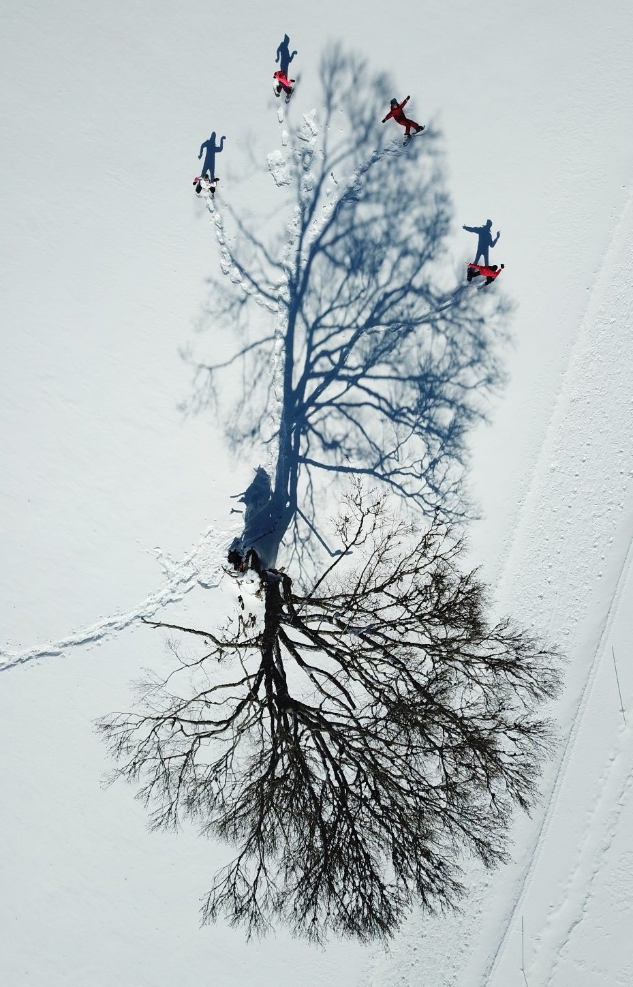
Title
Bullet points
© Cyrille Pillet, Well with Nature /EEA
Notes:
Slide with image and text

Slide 4
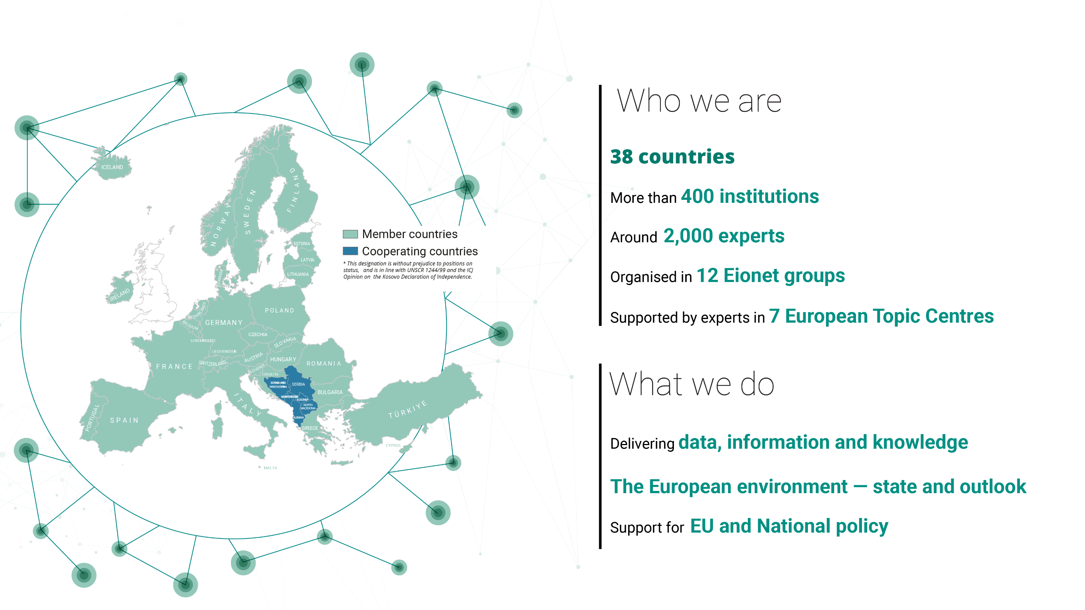

Slide 5
Title
Notes:
Blank slide with text

Slide 8
